Slide 1

Cloud-Based
Planetary Ephemerides
Austin Carlile
Minuka Trikawalagoda
Nicholas Gonzalez
Noah Schwartz
Notes:
Hello CS476 Faculty, Students, mentors and clients, we are In Your Orbit, a group focused on Cloud-Based Planetary Ephemerides

Slide 2




Meet the Team
Team Lead: Austin Carlile
Nicholas (Cole) Gonzalez
Minuka Trikawalagoda
Noah Schwartz
Notes:
A little intro to us, our team lead Austin Carlile, Nicholas (Cole) Gonzalez, Minuka Trikawalagoda, and I am Noah Schwartz

Slide 3

CS Faculty Mentor:
Scott Larocca
PhD Student with interests in:
remote sensing
tropical forest drought
how ecosystems respond to climate extremes.
Notes:
And this is our Mentor, Scott Larocca, a PhD Student with interests in remote sensing, tropical forest drought, and how ecosystems respond to climate extremes
From exploring the depths of Mars to preparing for the October 10th launch of the Europa Clipper mission, NASA’s planetary missions rely on precise data to unlock the secrets of distant worlds. But capturing and processing that data is no small feat.
Our client, Kelvin Rodriguez, along with his colleagues Amy Stamile, Christine Kim, and Adam Paquette, are all computer scientists at the USGS Astrogeology Science Center—and notably, Kelvin, Amy, and Adam are all alumni of NAU’s Computer Science program. Together, they are working to streamline the complex process of generating planetary sensor models, which are essential for NASA’s exploratory missions.

Slide 4

Our Client:
Founded in 1963, USGS Astrogeology supports NASA and global space agencies
Provides tools and data for planetary mapping, imagery processing and research
Expertise in sensor models and planetary imagery provides foundation for project
Extensive work with NASA’s SPICE data system
Notes:
SPICE (Spacecraft & Planetary ephemerides, Instrument C-matrix and Event kernels) refers to all the information that is required and computed in order for ISIS3 to map each image onto a surface with reference to spacecraft position, sun position, instrument and mission activities.

Slide 5
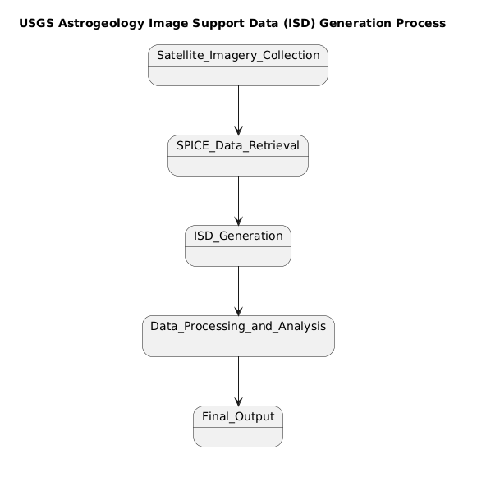
Client’s Business
Satellite imagery is collected
USGS retrieves SPICE kernels
Raw data is processed using USGS’ current software to generate Image Support Data (ISD) files

Slide 6
Problem Overview
Challenge: The existing process for generating ISD from NASA’s SPICE system requires users to download large datasets (up to a terabyte), which creates a roadblock for users, especially in high- performance computing environments.
Impact: Without ISD, planetary scientists cannot accurately geolocate imagery or perform various critical tasks such as mapping and photogrammetry for NASA missions.

Slide 7
Solution Approach
Web-Based Service: Develop a RESTful web service using Python to process planetary image labels and parameters.
Caching System: Implement a caching system to reduce ISD generation time by retrieving pre-calculated ISD files.
Data Reduction: Compress or convert large ISD files to reduce data footprint.
AWS Optimization: Design the system to efficiently run on AWS, taking advantage of its scalability features.

Slide 8
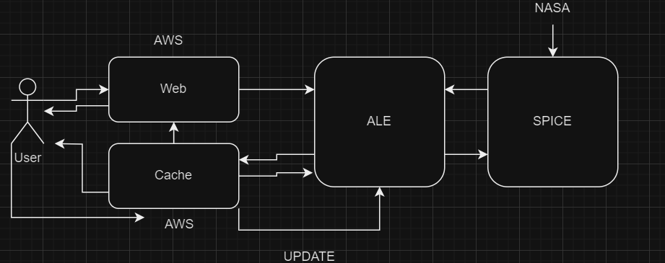

Slide 9
Plan for Development
Requirement Acquisition:
Weekly Client Meetings
Program architecture consulting
Data format refinement
Technical Investigation:
RESTful Web Service
ISD Caching
SPICE tags
ALE Library
Amazon AWS Servers
Amazon AWS Databases
Scalability

Slide 10

Conclusion
We are creating a web service and caching server for ISD images generated from NASA SPICE data
Previous solutions were inefficient and costly to maintain
Our solution will help the USGS Astrogeology team, NASA and future scientists at zero cost

